Slide 1
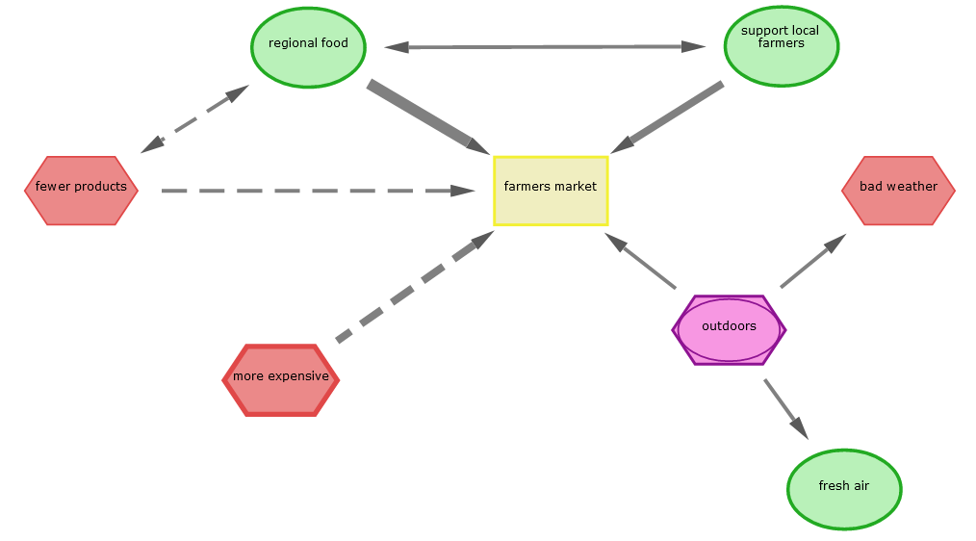

Slide 2

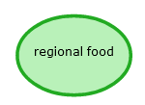
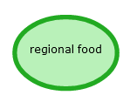
Konzepte
Julia feels positive about “regional food”.
Positive concepts are represented by green ovals.
The concept turns green when the slide bar is moved further to the right.
Slightly positive
Intermediate positive
Very positive
The slide bar offers three strengths for positive evaluation.
The thicker the border, the more positive the concept weighs!

Slide 3



Julia feels negative about “more expensive”.
Negative concepts are represented by red hexagons.
The concept turns more reddish when the slide bar is moved further to the left.
Slightly negative
Intermediate negative
Very negative
The slide bar offers three strengths for negative evaluation.
The thicker the border, the more negative the concept weighs!

Slide 4
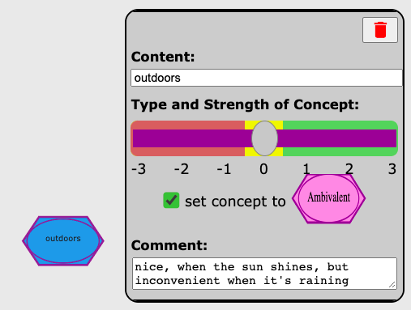

Julia is ambivalent about the fact that the farmers’ market is “outdoors”. Ambivalent indicates that Julia has mixed, meaning both positive and negative, feelings about it.
To indicate ambivalence, Julia clicks the box under the slider. Ambivalences are shown as superimposed violet ovals and hexagons.

Slide 5
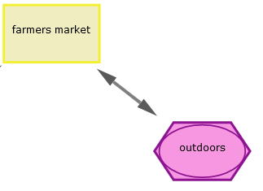

Verbindungen
To connect two concepts, Julia must single-click on both.
outdoors
Single-clicking on the second concept will lead to a double arrow appearing between the two concepts.
Single-clicking a concept will highlight the border in blue.

Slide 6
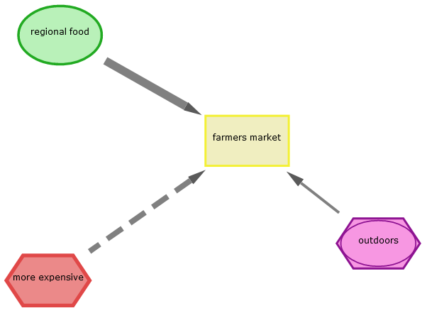
In comparison to the "regional" factor, “more expensive" food conflicts with “shopping at the farmers’ market“ and is represented by a dashed arrow.
This means: The more expensive the food, the less likely Julia is to go shopping at the farmers’ market.

